Slide 1


TEAM 42
MENTORS: Amy Shi-Nash, Daniel Usvyat
TA: Savannah Thais
Members: Nandhitha Raghuram, Yingyu Cao, Priyanka Lahoti, Sonali Medani, Tanvi Pareek
Notes:
Hi everyone, we are team 42. Our project is the London Electricity Usage Analysis.
Let me introduce the motivation and the dataset to you.

Slide 2

MOTIVATION
Background
Track energy usage and upgrade supply
Install Smart meters in every home
Goal
Identify the patterns of energy consumption
Forecast energy consumption
Suggest energy-saving strategies
Notes:
To better understand the electricity consumption and upgrade the energy supply to tackle climate change, the British government installed smart meters in every home in England, Wales, and Scotland. Based on the data from these meters, our project aims to identify the patterns and predict energy consumption, and then provide some suggestions on energy-saving strategies.

Slide 3
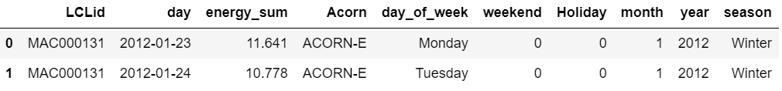
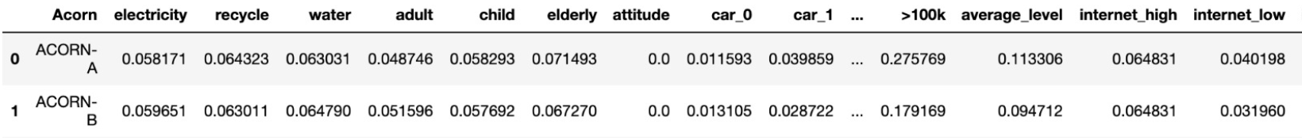
DATA SUMMARY
Source: Smart meters in London on Kaggle
5,567 households, Nov 2011 - Feb 2014
Daily electricity usage, weather, holidays, Acorn index, household information
Cleaned: 5,492 households, Jan 2012 to Feb 2014
Daily dataset
Acorn dataset
Notes:
Our data comes from the Smart meters in London dataset on Kaggle, which measures the electricity usage of 5567 households from November 2012 to February 2014. The data contains several tables: daily electricity usage, weather information such as temperature, humidity, and Acorn index. Acorn is a classification of UK population created by CACI International Inc. The company groups the population into 18 groups based on more than 800 metrics including family structure, age, economic and geodemographic information, etc. The dataset contains the index for those parameters in comparison to the national level that has an index of 100. We selected and regrouped those parameters into 47 features, and convert the index into percentages.
After merging the tables, dropping outliers. We obtained the two main datasets: the daily electricity consumption dataset, and the Acorn dataset.

Slide 4

EXPLORATORY DATA ANALYSIS
After exploring all features, the most important features that influence the energy consumption of each Acorn group are
Notes:
Having completed our pre-processing and cleaning of data, we went on analyse the effect of 47 features (as mentioned by Yingyu). I will be discussing some of the important features and their influence on energy consumption in the subsequent slides.

Slide 5
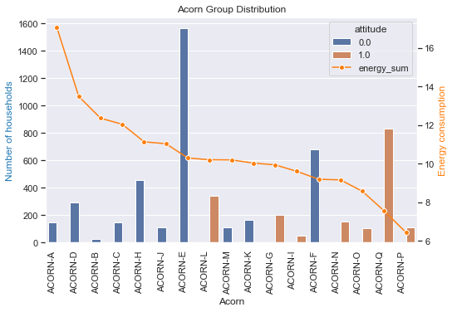
Energy consumption across Acorn groups
The number of households for each acorn group is not balanced.
Groups with positive attitude towards environment are on low end of energy consumption
Notes:
Firstly, we analyzed the distribution of acorn groups and their attitude towards environment. In this plot, orange bars represent groups that have positive attitude towards envmt and rest are shown in blue. The orange line represents the energy consumption. We can see here that most of the orange bars are on the right side showing that groups with positive attitude are on the lower end of energy consumption.
This plot also shows that the number of households for each acorn group is not the same. Acorn A, B and C have only few households but their mean energy consumption is very high. This discrepancy motivated us to see the influence of income.
LARGE GROUPS-> TARGETED AWARENESS => % IMPROVEMENT IN ENERGY CONSUMPTION

Slide 6
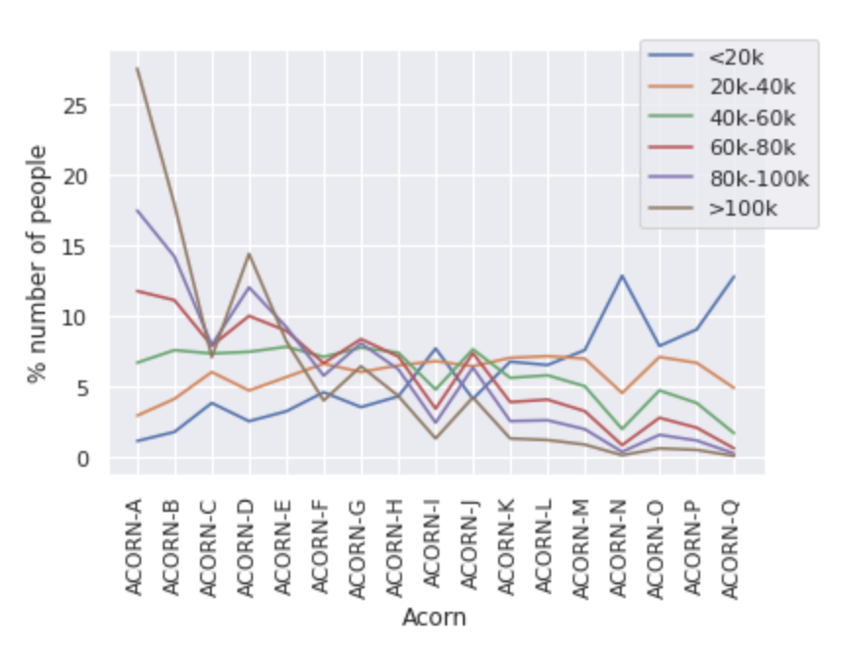
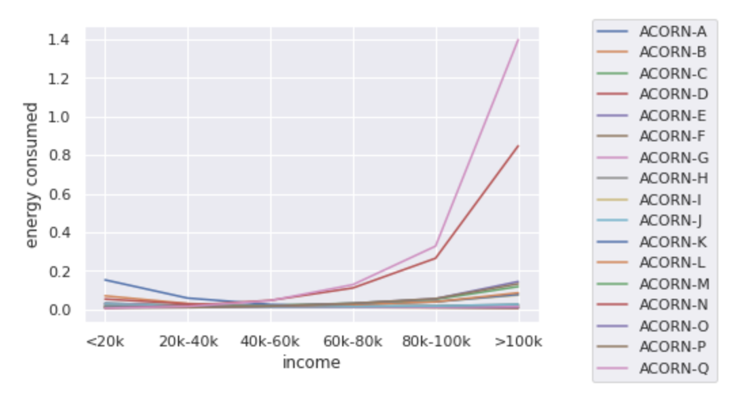
Income
Groups with higher income tend to consume more energy
Notes:
The plot on the right shows that income is positively correlated with energy consumption, i.e. more the income, higher is the energy consumed. As we saw on the previous slide that number of households for acorn A,B, C are very few, the plot on the left helps us to see that a high ratio of households for these groups belong to high income category (as can be seen by brown line). So, this helps us prove that the reason for high mean energy consumption seen for these acorn groups is because they consists of wealthier households.

Slide 7
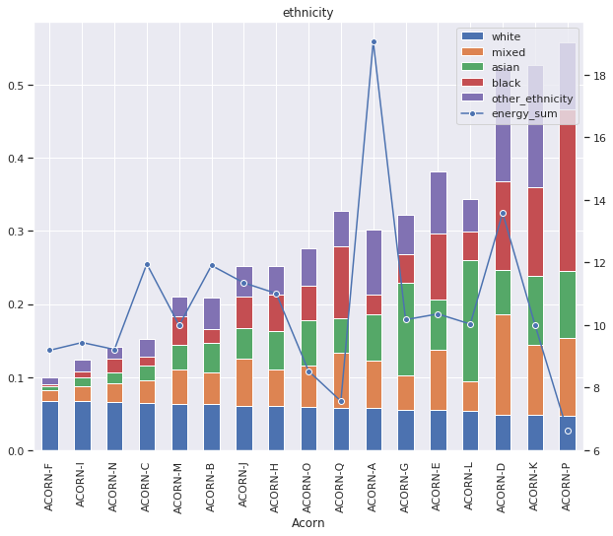
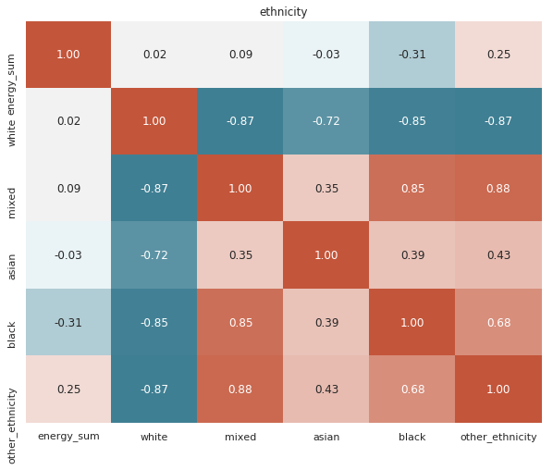
Ethnicity
No significant correlation between ethnicity and energy consumption
Notes:
Moving on, the next feature we analysed is ethnicity. The plots here show that there is no significant correlation between ethnicity and energy consumption(shown by blue line). And this is what we expected to see as well. However, from the red bar graph on the left showing the proportion of black households and correlation plot on the right, we see that there is a slight negative correlation between blacks and energy consumption. This did not make sense and so tried to explore the reason.

Slide 8
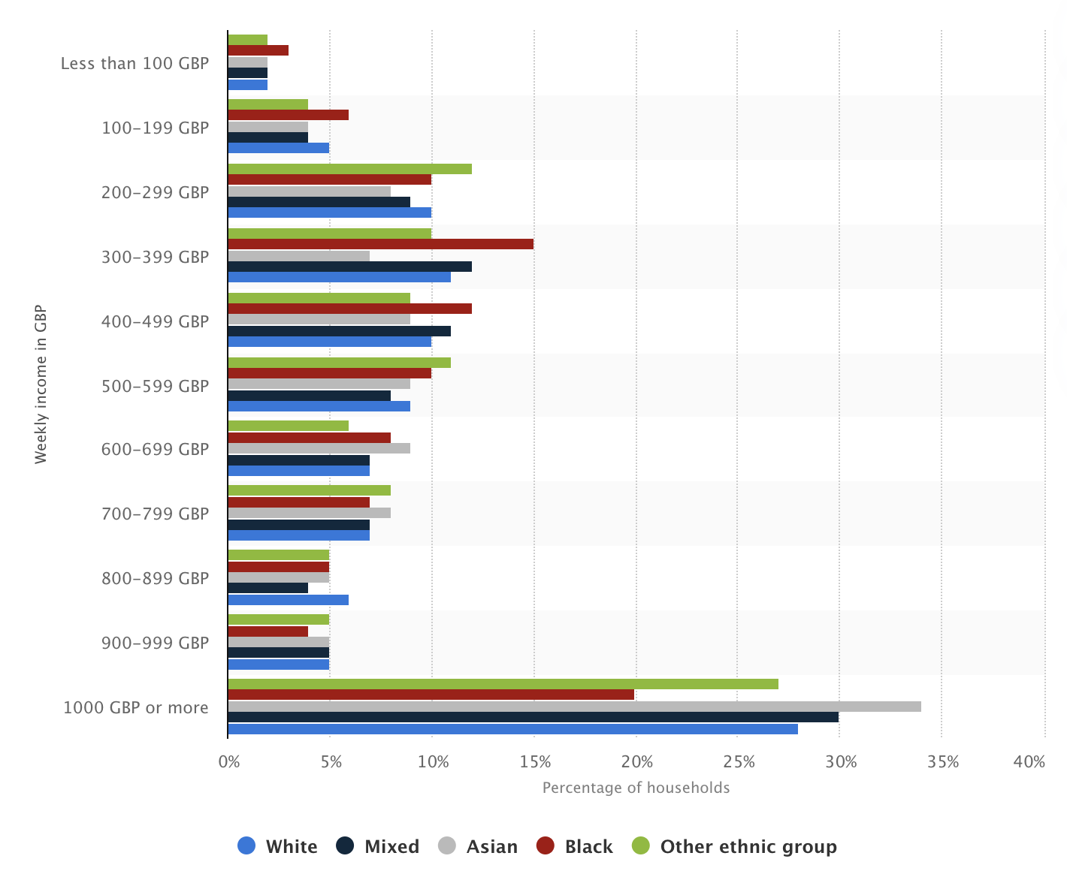
Ethnicity
Source: https://www.statista.com/statistics/944052/household-income-by-ethnicity-in-the-uk-2017/
Notes:
We found out there is a correlation between ethnicity and income. As we can see here the blacks (shown in the red) have higher percentage in the lower salary range and are among the least in the higher salary end. This shows that black households have income on lower end and thus, we observe the lesser energy consumption for them. This highlights a very important isue of ethicity pay gay in UK which we should do something about.

Slide 9
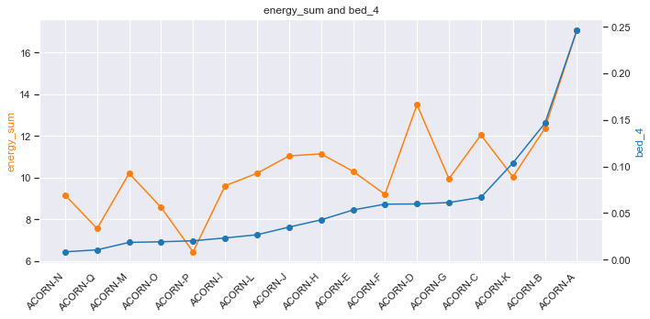
House sizes
More the size of the house, higher is the energy consumption
Notes:
The next feature we observed is House size, We can see that the energy consumption shown in orange is almost directly proportional to the house-size shown in blue. This is also obvious as this feature is also highly correlated with income as more the income, bigger the house, thus more bedrooms and appliances they own and so higher the energy consumption would be.
Now, I am gonna give it to tanvi to talk about some time related features that we explored.

Slide 10
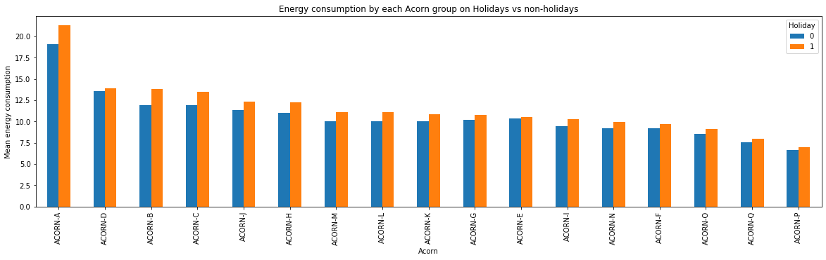
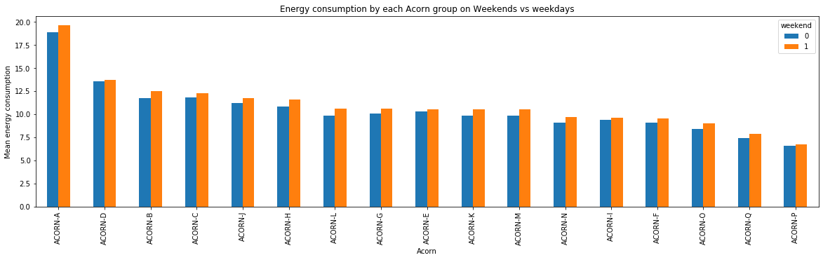
Energy consumption on holidays
Energy consumption on bank holidays and weekends is more as compared to other days.
Notes:
Across all groups, we expect to see higher energy consumption (do not mention large houses..)

Slide 11
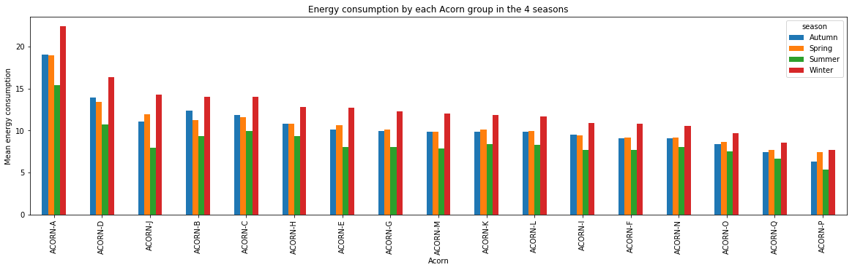
Seasons
Energy consumption is most in winter season and least in summer season across all acorn groups.

Slide 12
Modeling
ARIMA Time Series Forecast model is trained for each of 17 Acorn groups to forecast average daily energy consumption for each Acorn group.
80% data : training and 20% data : testing.
In the future more data can be used to train the time series model which can improve the accuracy of the existing model
Acorn | Acorn-A | Acorn-B | Acorn-C | Acorn-D | Acorn-E | Acorn-F | Acorn-G | Acorn-H
Error | 9% | 14% | 11% | 12% | 15% | 10% | 14% | 10%
Acorn-I | Acorn-J | Acorn-K | Acorn-L | Acorn-M | Acorn-N | Acorn-O | Acorn-P | Acorn-Q
4% | 14% | 11% | 9% | 10% | 11% | 15% | 13% | 11%

Slide 13
Recommendations
General suggestions
Installation of solar heaters
Hang laundry instead of using dryer
Unplug unused electronics
Regarding high energy consumption during holidays
Install programmable thermostat
Campaigns and advertisements advocating smarter energy consumption should be advertised more frequently on weekends and holidays
Use eco friendly decorations during holidays
Notes:
Having completed our analysis, let’s talk about the recommendations and strategies we propose to reduce energy consumption.
We know that we can reduce energy by … (general suggestions) however, we can now tackle the problem by focusing on the main contributors that we got from our analysis
For instance, we know that energy consumption is high during the weekends and holidays. Since people tend to have large gatherings and parties at home during holidays, there is enough warmth in the room which can be sensed and regulated by using programmable thermostat and thus, saving energy when needed. Further, we can switch to eco friendly decorations - eg using smart leds, and timer for lights (during christmas). We should also increase public awareness during weekends and holidays.

Slide 14
Recommendations
Specific Acorn groups
Acorn groups A,D,B,C,H are the top energy consuming groups
Campaigns should be targeted on major contributing features to these groups
Modeling based
If the energy consumption of a household in an acorn group is more than the predicted mean energy consumption of the acorn group to which it belongs, then can SMS/email notification should be sent to that particular household.
Notes:
We also observed that there are specific Acorn groups that consume more energy than others eg - Groups A, D,B,C,H are top consumer, thus we could focus on them to reduce overall energy consumption. We noticed that these groups don’t care too much about the environment and have high internet usage, so we can have targeted campaigns to promote awareness about these. (low streaming usage)
We can also use our model to predict the mean energy consumption of each acorn group and compare it with the smart meter readings of the households. If at any time, any household exceeds the predicted mean consumption, we can send an alarm notifying the household to be more careful.

Slide 15
Learning and Future Scope
Data used should be more recent for prediction and analysis
Features at household level in each acorn group can help enhance our inferences
Analysis restricted to acorn level (in this project) can be extended to household level
Geo-location of households for acorn groups could be useful for effective campaigning
Balanced data for acorn groups would be beneficial for accurate analysis
Notes:
Lastly I want to highlight our important learnings and the future scope of our project:
Data used could be more recent for better accuracy and analysis
If we could have features at an household level in each acorn group, we can better understand the acorn group and extend our analysis to household level as well
Having geo-location of households can be beneficial for better analysis and targeted campaigning
Furthermore, a balanced data can provide more accurate results and hence, increase confidence in our inferences

Slide 16

TEAM
Notes:
FUN TO BE PART ...PICTURE/COLLEGES … ACKNOWLEDGEMENT

